Slide 1

Acids and bases
Chemical and Physical Properties

Slide 2
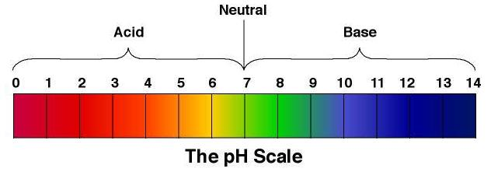
Overview
Essential chemistry, chapter 3
Recall the common reactions
Write net ionic equations for reactions involving acids and bases
Be able to identify and predict observations for reactions involving acids and bases

Slide 3
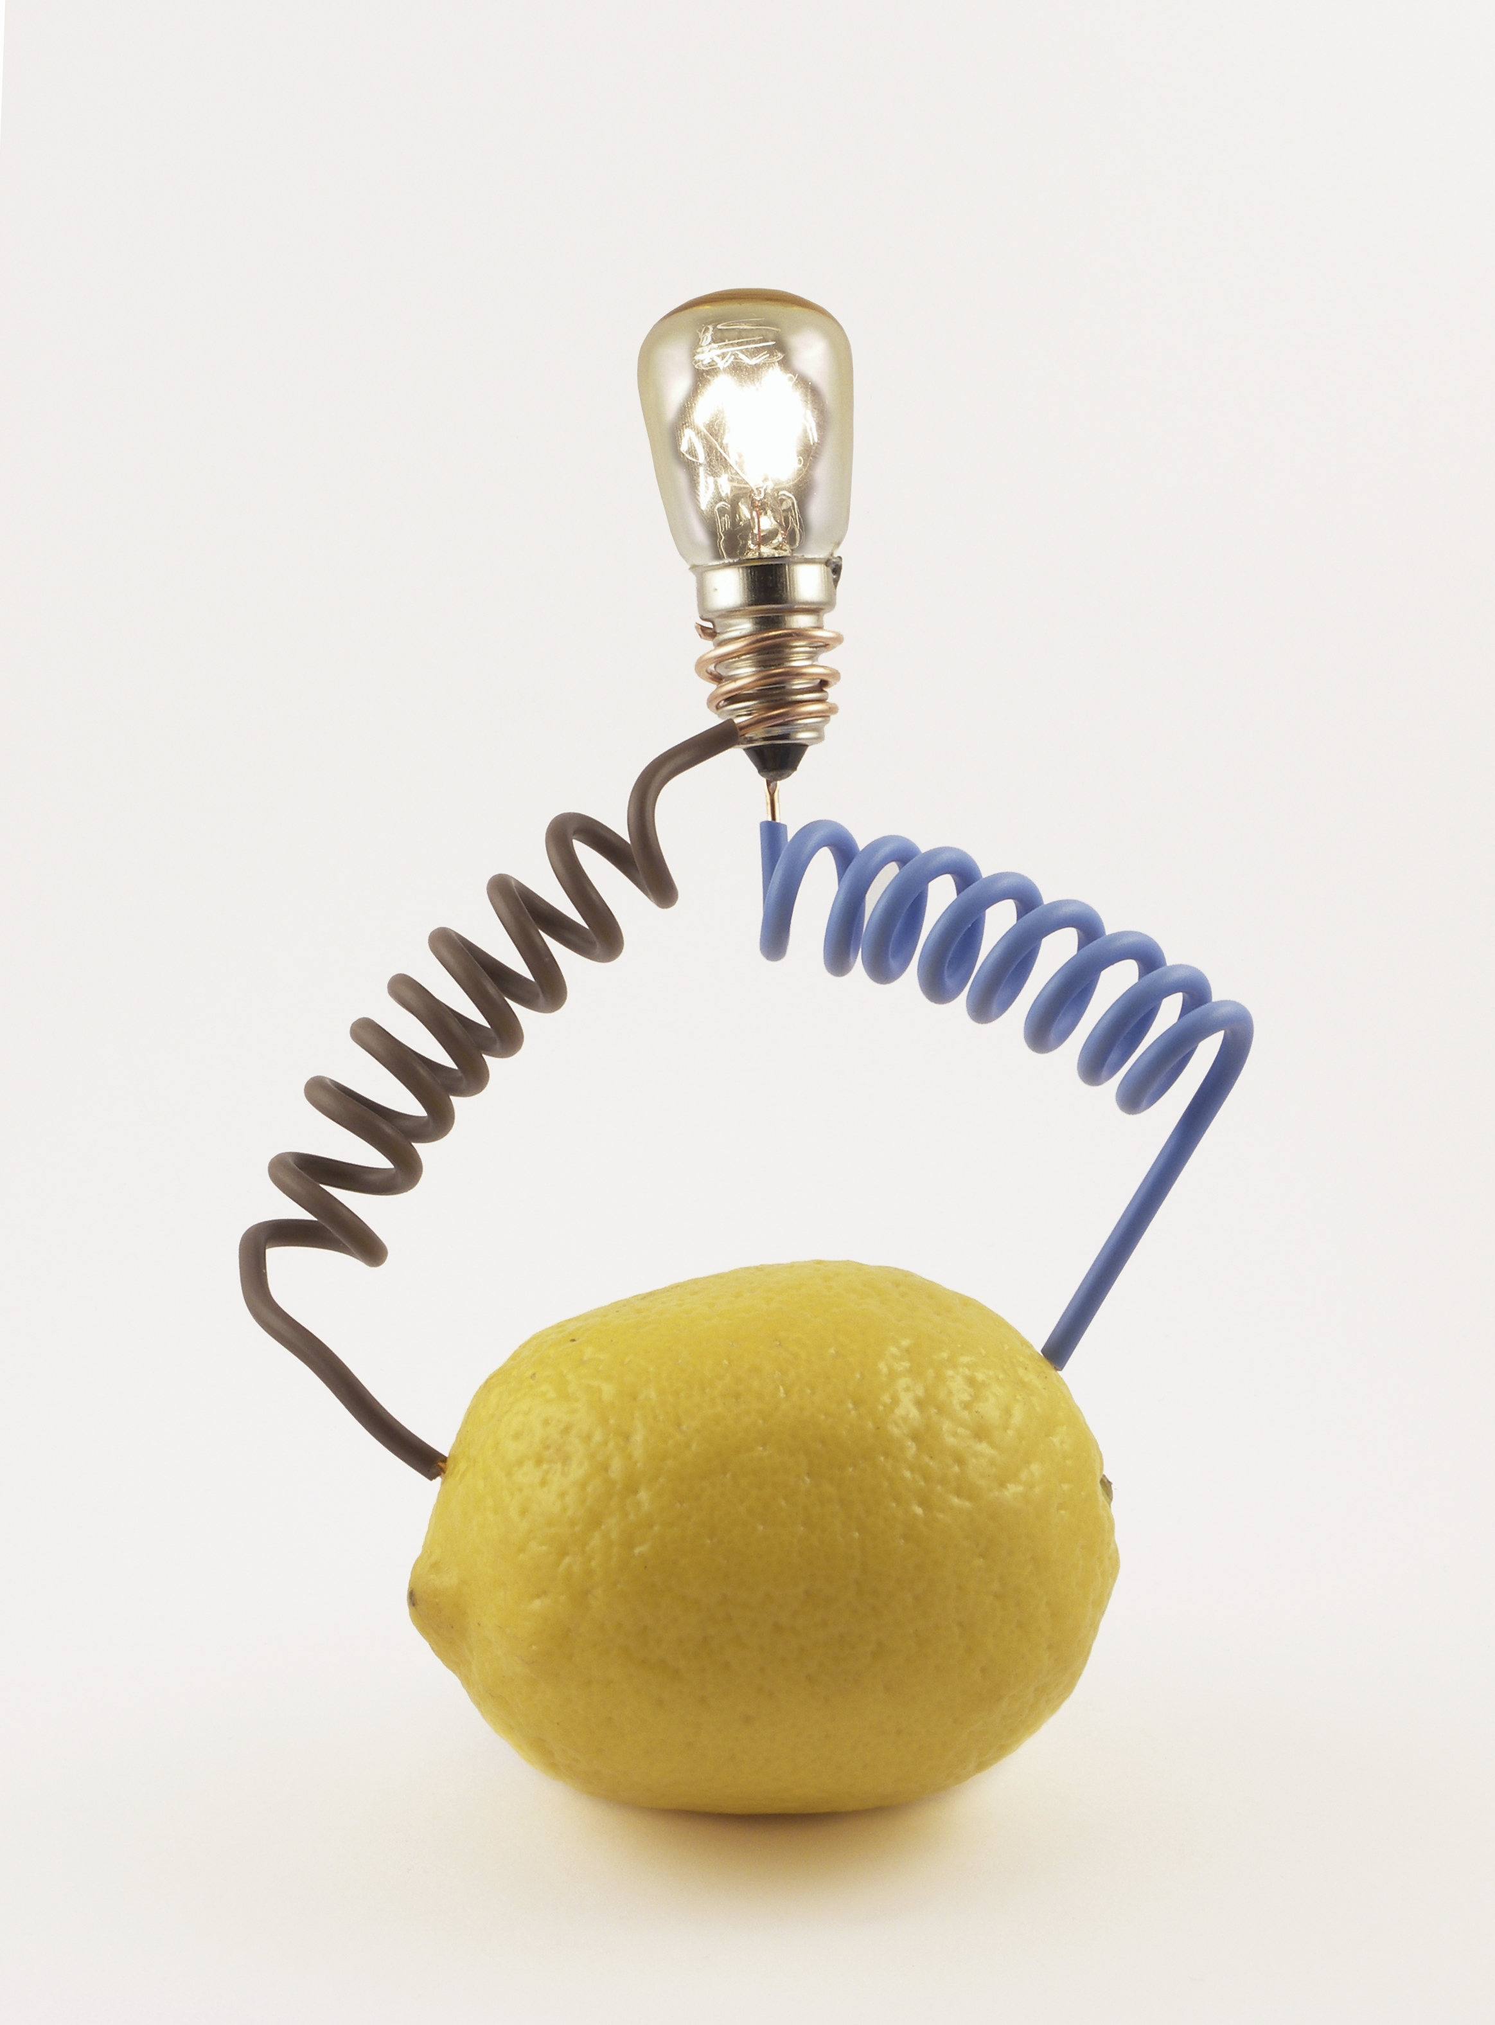
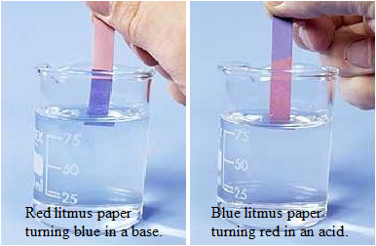
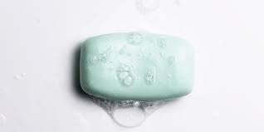
General properties
ACIDS | BASES
Conduct electricity | Conduct electricity
Turn blue litmus paper red | Turn red litmus paper blue
Sour taste | Bitter taste
 | Slippery, soapy feel

Slide 4
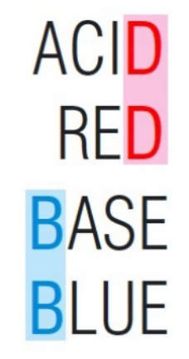
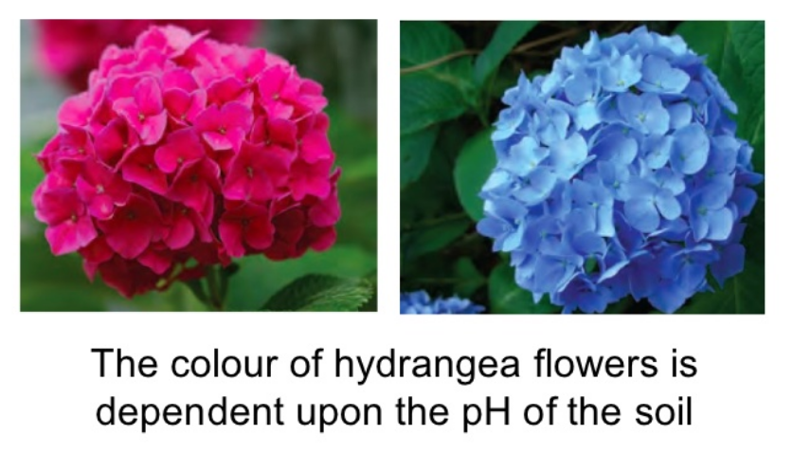
General properties

Slide 5
Examples of acids and bases
Common Acids | Common Bases
Hydrochloric acid HCl | Sodium hydroxide NaOH
Sulfuric acid H₂SO₄ | Ammonia NH₃
Nitric acid HNO₃ | Ammonium hydroxide NH₄OH
Ethanoic acid CH₃COOH | Magnesium hydroxide Mg(OH)₂
Citric acid | Sodium hydrogen carbonate – baking soda NaHCO₃
Carbonic acid

Slide 6
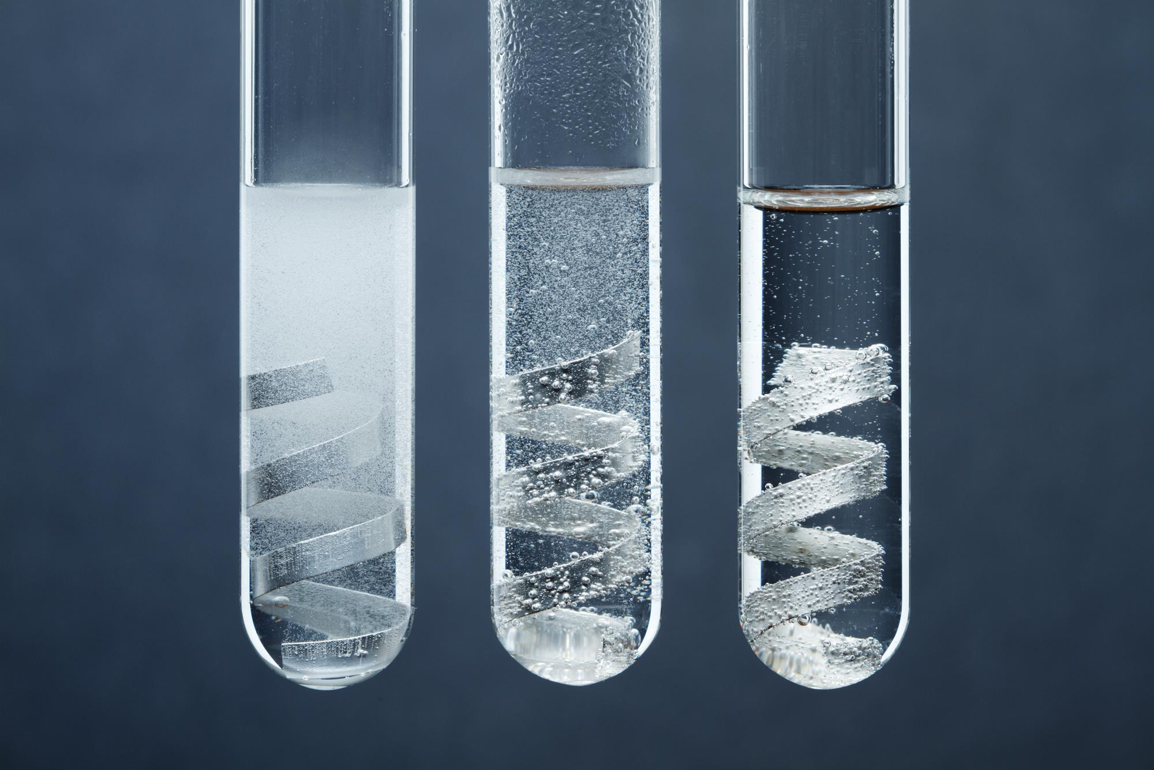
Chemical reactions
Acid + metal → salt + hydrogen gas
Example: Ni_{(s)} + HCl_{(aq)} → NiCl_{2(aq)} + H_{2(g)}
Ni_{(s)} + H⁺_{(aq)} → Ni²⁺_{(aq)} + H_{2(g)}
Observations:
Effervescence (formation of bubbles)
test for hydrogen gas formation using a “Pop test”
Metal dissolves over time

Slide 7
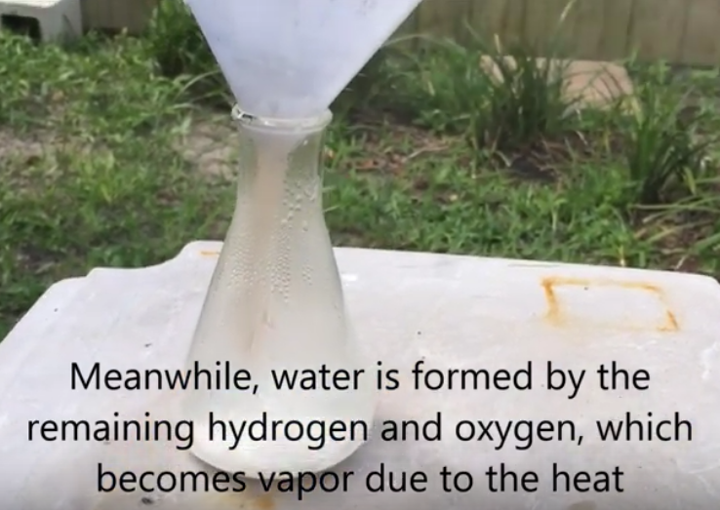
Chemical reactions
Acid + metal hydroxide → salt + water
Example: Ca(OH)_{2(s)} + 2 HNO_{3(aq)} → Ca(NO₃)_{2(aq)} + 2 H₂O_{(l)}
Ca(OH)_{2(s)} + 2 H⁺_{(aq)} → Ca²⁺_{(aq)} + 2 H₂O_{(l)}
Observations:
Exothermic
If added solid base to acid, reactions often gets so hot the water that forms vaporises
If salt formed is insoluble you will form a precipitate
Video:
https://www.youtube.com/watch?v=wnr-i_vA9nw

Slide 8
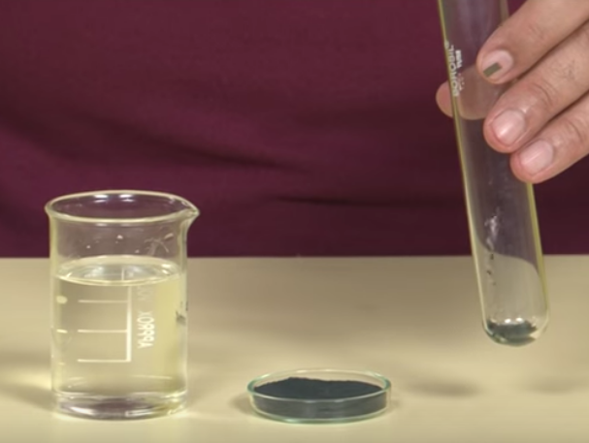
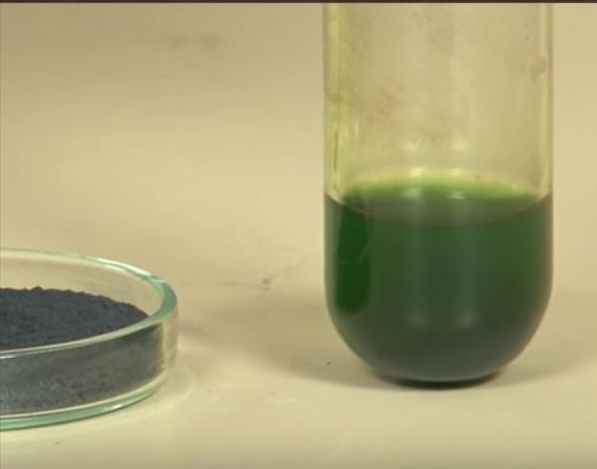
Chemical reactions
Acid + metal oxide → salt + water
Example: CuO_{(s)} + H₂SO_{4(aq)} → CuSO_{4(aq)} + H₂O_{(l)}
CuO_{(s)} + 2 H⁺_{(aq)} → Cu²⁺_{(aq)} + H₂O_{(l)}
Observations:
Oxide (which may be insoluble) will dissolve
Use colour and solubility tables to then predict final obseravtions
Copper oxide (insoluble) with hydrochloric acid gives a green solution of copper chloride dissolved in water. Video: https://www.youtube.com/watch?v=9Gop1AdWKaI

Slide 9
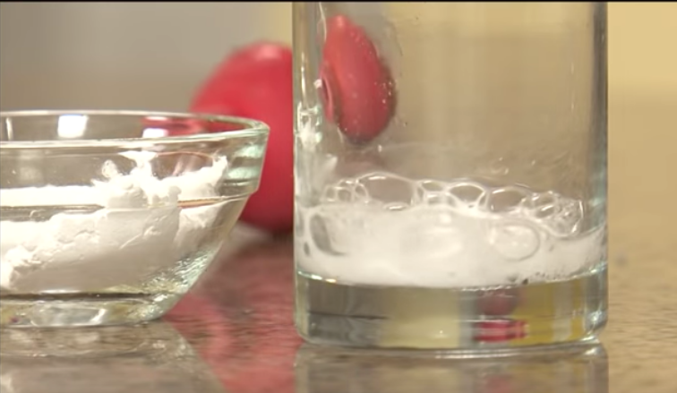
Chemical reactions
Acid + metal carbonate → salt + water + carbon dioxide gas
Example: NiCO_{3(s)} + 2 HCl_{(aq)} → NiCl_{2(aq)} + H₂O_{(l)} + CO_{2(g)}
NiCO_{3(s)} + 2 H⁺_{(aq)} → Ni²⁺_{(aq)} + H₂O_{(l)} + CO_{2(g)}
Observations:
Effervescence (formation of bubbles)
If hold a match over the beaker, it will go out
Video: https://www.youtube.com/watch?v=CreO-rVrxT0

Slide 10
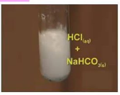
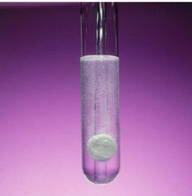
Chemical reactions
Acid + metal hydrogencarbonate → salt + water + carbon dioxide gas
Example: Ni(HCO₃)_{2(s)} + 2HCl_{(aq)} → NiCl_{2(aq)} + 2H₂O_{(l)} + 2CO_{2(g)}
Ni(HCO₃)_{2(s)} + 4H⁺_{(aq)} → Ni²⁺_{(aq)} + 2H₂O_{(l)} + 2CO_{2(g)}
Observations:
Effervescence (formation of bubbles)
If hold a match over the beaker, it will go out

Slide 11
Chemical reactions
Acid + metal sulfite → salt + water + sulfur dioxide gas
Example: Ni₂SO_{3(s)} + 2HCl_{(aq)} → 2NiCl_{2(aq)} + H₂O_{(l)} + SO_{2(g)}
Ni₂SO_{3(s)} + 2H⁺_{(aq)} → 2Ni²⁺_{(aq)} + H₂O_{(l)} + SO_{2(g)}
Observations:
Note – it is sulfite SO₃ NOT sulfate SO₄
This is extension and will not be done in our class as sulfur dioxide gas is a bad asthma trigger
Effervescence (formation of bubbles)

Slide 12
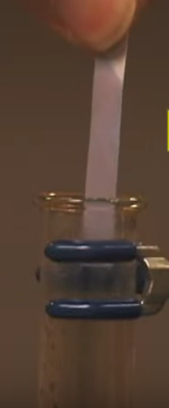
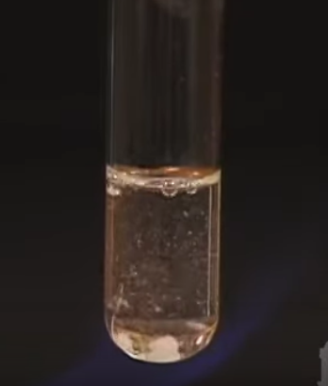
Chemical reactions
Base + ammonium salt → salt + water + ammonia gas
Example: KOH_{(aq)} + NH₄Cl_{(aq)} → KCl_{(aq)} + H₂O_{(l)} + NH_{3(g)}
OH⁻_{(aq)} + NH₄⁺_{(aq)} → H₂O_{(l)} + NH_{3(g)}
Observations:
Effervescence (formation of bubbles)
Gas produced turns red litmus paper blue (hold it over the beaker)
Video: https://www.youtube.com/watch?v=LUEakMDNRsM

Slide 13
Chemical reactions
Base + non-metal oxide → salt + water
Example: 2KOH_{(aq)} + SO_{2(g)} → K₂SO_{3(aq)} + H₂O_{(l)}
2OH⁻_{(aq)} + SO_{2(g)} → SO₃²⁻_{(aq)} + H₂O_{(l)}
Observations:
Considered a two-step process – first the non-metal oxide (sulfur dioxide, carbon dioxide, nitrogen dioxide, phosphorous (v) oxide) reacts with the water to form an acid solution. The acid formed then reacts with the base to form the salt and water (see essential chemistry)

Slide 14
On-going work
Pearson 17.3
Prep for STAWA expt 31

